Slide 1
NLP for CNL Customization
Application in the STIX-D Project
by Mike Benson
Notes:
Today, we'll walk through the application of Natural Language Processing (NLP) within the context of customizing Controlled Natural Languages (CNLs) in the STIX-D project.

Slide 2
Agenda
Problem
Background
Relation to Data Mining
Real-World Applications
Worked Example
Conclusion
Notes:
The presentation will start with defining the problem and provide background information, then relate our work to the topics we've covered in class. I'll also demonstrate a real-world application, provide a detailed example, and conclude with a summary.

Slide 3
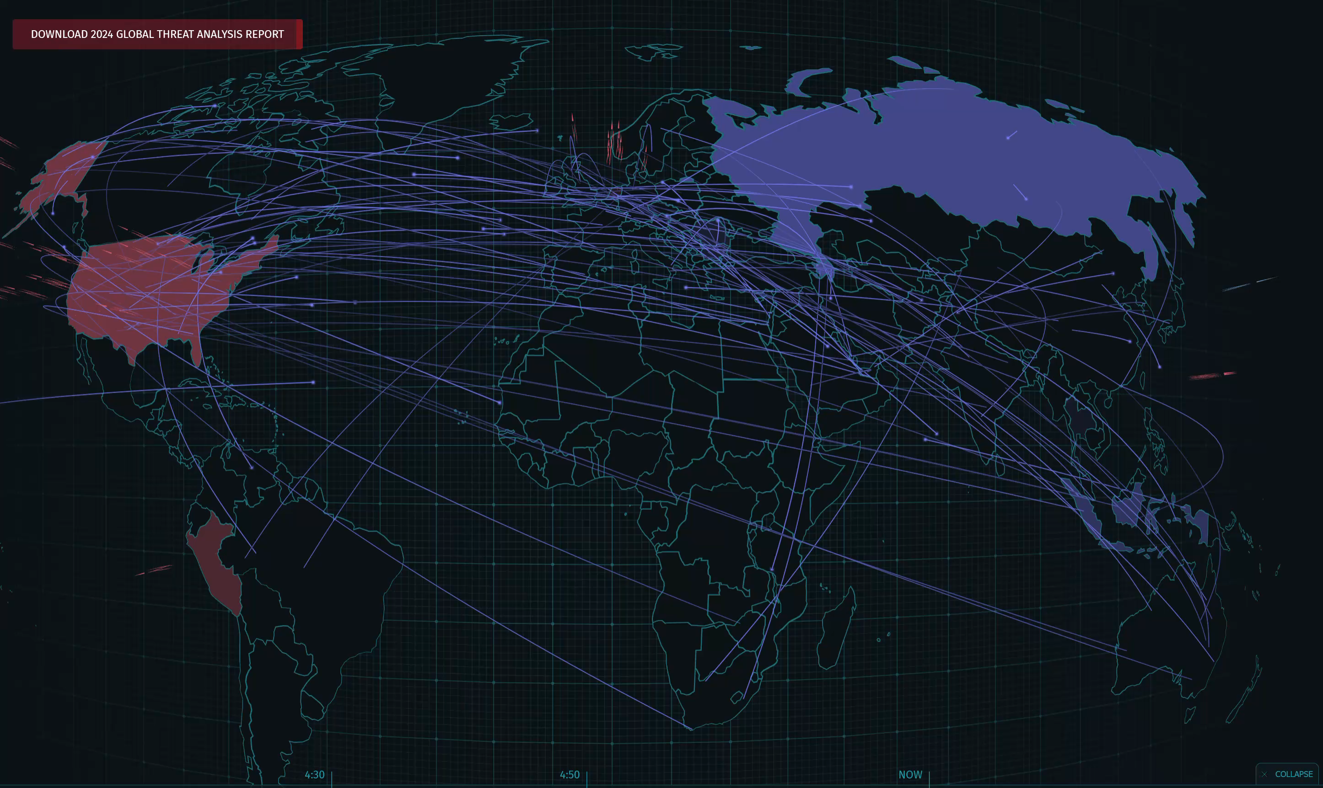
Show live cyber threat heatmap from https://livethreatmap.radware.com/
Notes:
As you can see on this live heatmap, cyber attacks are not just frequent—they are constant and automated. This visualization represents just a fraction of the millions of attacks happening every day across the globe.
Luckily, automated security systems help us fend off about 99% of these attacks. However, that still leaves us with thousands of attacks per day that need further investigation.
This overwhelming volume underscores the need for more capable and automated cyber threat intelligence, or CTI, systems. Traditional methods struggle to keep up with the pace and scale of modern cyber threats.
This is why the development of more advanced, automated CTI solutions is critical in protecting our digital infrastructure and staying ahead of these relentless cyber threats.

Slide 4
Background
A brief introduction to CTI, NLP, and CNL
Notes:
Before we dive into data mining, it is essential to understand CTI and how we process and control natural language.
This section will cover the fundamental techniques used to manage and refine text data, making it suitable for machine interpretation and analysis.
By understanding these processes, we lay the groundwork for effectively applying data mining techniques in the context of NLP.

Slide 5
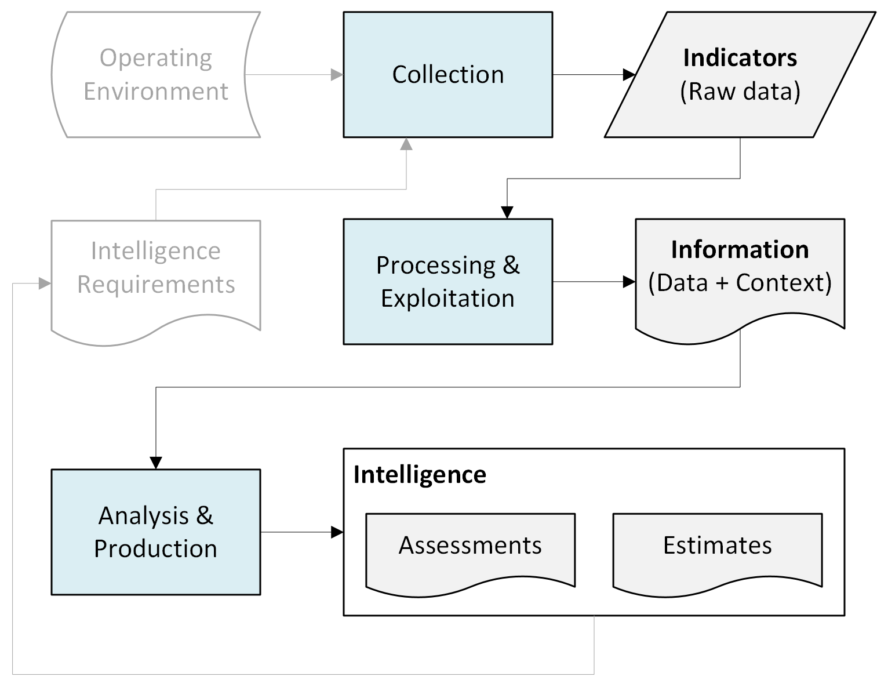
What is CTI?
Evidence-based knowledge on existing or emerging threats
Inform decision makers
Cyber Threat Intelligence
Indicators: A+
Information: A-
Intelligence: C-
Uses natural language
Notes:
Two slides ago, I introduced the concept of Cyber Threat Intelligence, or CTI, which plays a crucial role in informing both leadership and network security personnel about existing and emerging cyber threats.
CTI is composed of three main components: indicators, information, and intelligence. Each of these components has different levels of grammatical complexity and requires varying degrees of machine processing.
Indicators are the foundational raw data of CTI, such as malicious IP addresses or file hashes. Machines excel at processing these because the data is highly structured and predictable (i.e., regular grammar). This is why I give machines an A+ for processing indicators.
Information builds on indicators by adding context—linking them to other indicators or providing additional details. Machines do a very good job at processing this, but sometimes struggle with nuances in context, leading us to assign an A- grade. (context-free to context-sensitive; very little unrestricted grammar)
Intelligence represents the final, most complex stage. It involves analyzing all relevant information to produce assessments and estimates. Here, machines face significant challenges due to the inherent ambiguity in natural language. This ambiguity makes it difficult for machines to fully understand context, intentions, or subtleties in the text. As a result, we assign machines a C- grade in processing finished intelligence.
To address these limitations, there is a clear need to restrict intelligence and more complex information text to a Controlled Natural Language (CNL). By reducing ambiguity and complexity in the language, CNLs can help improve the accuracy and reliability of machine processing, making CTI more effective overall.

Slide 6
What is a Natural Language (NL)?
Natural human-spoken language
Evolved organically over time (e.g., English, Mandarin, Farsi)
For general communication of all human knowledge
Descriptive grammar rules
Vocabulary (a.k.a. lexicon)
Dynamic lexicon with multiple meanings per words or phrases; synonyms
Construction rules (a.k.a. syntax)
Limitless ways to arrange words to form sentences
Interpretation rules (a.k.a. semantics)
Potentially multiple meanings in a sentences, particularly complex ones
Challenging for non-native speakers and machines to process
Notes:
“What do we mean by a natural language? These are the languages humans use every day—languages like Spanish, Korean, or Swahili. These languages weren't created overnight; they developed naturally over centuries through human interactions, evolving to meet the needs of their speakers. Unlike constructed languages, such as Elvish or Valyrian, which were intentionally designed, natural languages grow organically.
One of the key characteristics of natural languages is that they’re designed to communicate the full range of human experiences. This makes them incredibly versatile but also incredibly complex. The grammar rules that govern natural languages are descriptive, meaning they reflect how people actually use the language, not how someone thinks the language should be used.
When we talk about the vocabulary, or lexicon, of a natural language, we’re dealing with a dynamic system. Words can have multiple meanings, and there are often synonyms that can make interpretation more complex. This flexibility extends to syntax, the rules for constructing sentences. In natural languages, there are virtually endless ways to arrange words to express ideas.
Finally, interpretation—or semantics—is another area where natural languages show their complexity. The meaning of a sentence can often depend on the context, which can lead to multiple interpretations. This flexibility is a strength in everyday communication, but it can also be a source of ambiguity."

Slide 7
What is Natural Language Processing (NLP)?
Techniques to analyze, understand, and generate human language
Enables computers to process, interpret, and respond to NLs
Computationally expensive
Key terms
Corpus: Machine-readable collection of raw text or speech
NLP Pipeline: Steps to turn a corpus into structured data
Notes:
"Now that we’ve covered what natural language is, let’s move on to Natural Language Processing, or NLP. NLP is fundamentally about using computational methods to interact with human languages. It involves a range of techniques to analyze, understand, and even generate language, making it possible for computers to bridge the gap between human communication and machine processing.
The goal of NLP is to enable computers to process, interpret, and respond to natural language, just as a human would. This is achieved through a series of steps known as an NLP pipeline. In this pipeline, raw text is turned into structured data, often through processes like data preprocessing, word tagging, feature extraction, and model training.
By applying data mining techniques to the structured data produced by NLP, we can extract patterns and insights that would otherwise be hidden in large text datasets. However, it’s important to note that NLP outcomes can be non-deterministic. This is because natural languages are inherently ambiguous, meaning the same input might lead to different outputs depending on context or interpretation.
Given these challenges, there’s a clear need for a less ambiguous language that can be easily processed by both humans and machines. This leads us to the concept of Controlled Natural Languages, or CNLs, which I’ll cover next."

Slide 8
What is a Controlled Natural Language (CNL)?
Created subset of one natural language to
Improve clarity and reduce ambiguity in a specific domain
Facilitate translation and automated processing
Prescriptive grammar rules
Vocabulary (aka lexicon)
May have smaller, static lexicon with one meaning per word or phrase
Construction rules (aka syntax)
May allow only simple sentences with no clauses
Interpretation rules (aka semantics)
One meaning per sentence
Easier for non-native speakers and machines to process
Notes:
“Controlled Natural Languages, or CNLs, are more restrictive than natural languages. A CNL is essentially a structured subset of a natural language. Unlike natural languages that evolved naturally, CNLs are deliberately designed for a specific purpose, usually to facilitate precise communication in a particular domain, such as technical documentation, aviation, legal texts, or cybersecurity.
Where natural languages have descriptive grammar rules that reflect usage, CNLs employ prescriptive grammar rules. These rules are strict and clearly defined to minimize ambiguity and ensure that everyone understands the language in the same way.
When it comes to vocabulary, a CNL often has a much smaller and static lexicon compared to a natural language. Every word in a CNL typically has one clear, unambiguous meaning, and may exclude synonyms to prevent confusion.
The syntax, or construction rules, in a CNL is also more restrictive. The goal is to allow only simple sentence structures, usually without clauses, to keep the communication clear and straightforward.
Finally, in terms of semantics, the interpretation rules in a CNL are designed so that every sentence has only one meaning. This is crucial for the kind of precise communication that CNLs are meant to achieve, especially in fields where misunderstanding can have serious consequences.
These features a CNL make it easier for humans and machines to process by removing ambiguities and allowing for deterministic processing.

Slide 9
Why use Attempto Controlled English (ACE)?
Unambiguous interpretation
Formal Semantics
Looks like natural English
Customizable grammar rules
Example of NL vs ACE
NL: A manager calls a subordinate. She asks him some questions.
ACE: A manager calls a subordinate. The manager asks the subordinate some questions.
Notes:
"Let's discuss why we've chosen Attempto Controlled English, or ACE, as the foundation for developing the Controlled Natural Language (CNL) in the STIX-D project.
First, ACE is unambiguous by design. In natural language, it's easy for sentences to be interpreted in different ways, which can lead to misunderstandings—especially in critical fields like cybersecurity. ACE eliminates this risk by ensuring that every sentence has a single, clear interpretation. This is crucial when describing cyber threats, where ambiguity can lead to significant operational risks.
Second, ACE’s formal semantics provide a solid foundation for automated reasoning. Every ACE sentence can be translated into first-order logic, which allows us to apply rigorous mathematical analysis and automated processes to the data. This capability is essential for verifying the accuracy and consistency of threat descriptions within STIX-D.
Despite its precision, ACE remains user-friendly. It closely resembles natural English, so even those without a background in linguistics can learn and use it effectively. This accessibility is important for encouraging widespread use among cybersecurity professionals who need to communicate complex threat information clearly.
Lastly, ACE’s adaptability makes it a perfect fit for our needs. It can be customized with specific vocabulary and rules relevant to cybersecurity, allowing us to tailor the language to the specific requirements of describing cyber threats in STIX-D.
In summary, ACE provides the right balance of precision, usability, and adaptability, making it an excellent choice for the STIX-D project’s Controlled Natural Language.“
To the right we have a simple example of the same idea expressed in natural English and ACE. Note how ACE removes the ambiguity from the sentences..

Slide 10
Data Mining in NLP
Relating NLP to INFO 523
Notes:
In the previous section, we explored how we can control natural language to improve the clarity and consistency of cybersecurity communications.
Now, we will shift our focus to data mining techniques.
These techniques are crucial for analyzing and structuring the vast amounts of text data that we deal with in NLP and CNL customization.

Slide 11
Data Mining in NLP/CNL Customization
Text Classification
HMM, CRF, BERT
Clustering
K-means, Hierarchical, DBSCAN
Topic Modeling
LDA, LSA
Named-Entity Recognition
CRF, HMM
Sentiment Analyses
Logistic Regression, BERT
Association Rule Mining
Apriori algorithm, FP-Growth
Text Summarization
TextRank, PageRank
Dimensionality Reduction
PCA, t-SNE, Word2Vec, GloVe
Information Retrieval
VSM, BM25,
Anomaly Detection
One-class SVM, Isolation Forest
Notes:
This slide provides an overview of how data mining methods are integral to the process of customizing Natural Language Processing (NLP) and Controlled Natural Language (CNL) systems, specifically within the context of the STIX-D project. In our project, we're leveraging a variety of data mining techniques to analyze and structure large amounts of text data, which is crucial for developing an effective CNL.
These techniques allow us to classify text, discover hidden patterns, and extract meaningful information from unstructured data, which is essential for creating a precise and unambiguous language model. Whether we're clustering similar text segments, identifying key entities, or summarizing long documents, data mining tools help us transform raw text into structured data that can be processed and interpreted consistently.
By applying these methods, we're not just improving the accuracy and efficiency of our NLP pipeline; we're also ensuring that the resulting CNL is tailored to the specific needs of cybersecurity, allowing for clearer and more reliable threat descriptions in the STIX-D framework.

Slide 12
Text Classification
Tag | Description
ADJ | Adjective
ADV | Adverb
NOUN | Noun
VERB | Verb
PROPN | Proper name
INTJ | Interjection
ADP | Adposition (preposition/postposition)
AUX | Auxiliary verb (i.e., modal)
CCONJ | Coordinating conjunction
DET | Determiner
NUM | Numeral
PART | Particle
PRON | Pronoun
SCONJ | Subordinating conjunction
PUNCT | Punctuation
SYM | Symbol
X | Other
Part-of-Speech tagging
Assign 1 tag to each word
Input: words and a tagset
Output: Seq of tags
A disambiguation task
Algorithms: HMM, CRF, BERT
Tagsets: Course to fine
Accuracy: ~97% regardless of
Algorithm or tagset
Notes:
In this slide, we are focusing on Text Classification, particularly in the context of Part-of-Speech (POS) tagging. POS tagging is a fundamental task in Natural Language Processing (NLP) where each word in a sentence is assigned a part of speech, such as a noun, verb, adjective, etc. This process helps in understanding the grammatical structure of sentences, which is crucial for further linguistic analysis.
The task of POS tagging is primarily a disambiguation task. Many words in English and other languages can belong to multiple parts of speech depending on the context. For example, the word "book" can be a noun (as in "a book on the table") or a verb (as in "to book a ticket"). The goal of a POS tagger is to assign the correct tag to each word in the given context.
Several algorithms are commonly used for POS tagging, including:
Hidden Markov Models (HMMs): A probabilistic model that predicts the most likely sequence of tags based on the sequence of words.
Conditional Random Fields (CRFs): A discriminative model that considers both the sequence of words and the relationships between the tags.
BERT (Bidirectional Encoder Representations from Transformers): A deep learning model that uses context from both directions in a sentence to predict the part of speech.
These algorithms operate on various tagsets ranging from coarse-grained to fine-grained. The tagset shown here is based on the Universal Dependencies (UD) framework, which includes tags for major word classes such as adjectives, adverbs, nouns, and verbs, among others.
Accuracy in POS tagging is quite high, generally around 97% regardless of the algorithm or tagset used. This level of accuracy is crucial for applications that require precise linguistic analysis, such as syntactic parsing, information extraction, and machine translation.

Slide 13
The STIX-D Project
A real-world application of using NLP Data Mining for CNL customization
Notes:
As we transition, I will introduce you to the STIX-D Project.
This project exemplifies a real-world application of using NLP Data Mining to customize a Controlled Natural Language for the cyber threat intelligence domain.

Slide 14
Purpose of STIX-D Project
To develop a Controlled Natural Language (CNL) and necessary tools for Structured Threat Information eXpression (STIX) descriptions within the Cyber Threat Intelligence (CTI) domain. The CNL will be a custom subset of Attempto Controlled English (ACE). The goal of the project is to improve the efficiency and efficacy of automated CTI systems in processing natural language texts.
Notes:
As outlined on this slide, the purpose of the STIX-D Project is to develop a Controlled Natural Language (CNL) and the necessary tools for STIX descriptions.
This CNL will be a custom subset of Attempto Controlled English (ACE).
My goal is to improve the efficiency and efficacy of automated CTI systems in processing natural language texts, making threat intelligence more precise and actionable.

Slide 15
What is STIX?
A language and serialization format for sharing CTI
STIX objects categorize each data with specific attributes
`description` field (optional)
Natural language ‘free’ text
Provides more details & context
Purpose & key characteristics
How used; relation to other objects
{
"type": "campaign",
"id": "campaign--8e2e2d2b-17d4-4cbf-938f-98ee46b3cd3f",
"spec_version": "2.1",
"created": "2016-04-06T20:03:00.000Z",
"modified": "2016-04-06T20:03:23.000Z",
"name": "Green Group Attacks Against Finance",
"description": "Campaign by Green Group against targets in the financial services sector."
}
Notes:
STIX is a standardized language and format used for sharing cyber threat intelligence.
It categorizes each piece of data with specific attributes, allowing for a structured approach to analyzing threats.
The 'description' field, highlighted here, is optional but highly valuable.
It provides natural language text that offers more details, context, and insights into the nature and purpose of the threat.
While this flexibility in the description field is beneficial, it also introduces challenges, especially when complex language is involved, which can be difficult for automated systems to process effectively.

Slide 16
STIX Description Examples
A description provides more details and context about the STIX object including its purpose and its key characteristics.
1. "description": "A variant of the cryptolocker family"
2. "description": "The Evil Org threat actor group"
3. "description": "This file is part of Poison Ivy“
4. "description": "A particular form of spear phishing where the attacker claims that the target had won a contest, including personal details, to get them to click on a link."
5. "description": "Incidents usually feature a shared TTP of a wildcat being released within the building containing network access, scaring users to leave their computers without locking them first. Still determining where the threat actors are getting the wildcats."
Notes:
Here are a few examples of STIX Descriptions.
Notice how these descriptions vary in complexity and adherence to the STIX guidelines.
Not every description clearly provides the purpose and key characteristics of the threat, which can complicate their analysis.
Also, note that the more complex sentence structures, such as those seen in Examples 4 and 5, pose significant challenges for computers, particularly in understanding and processing these descriptions accurately..

Slide 17
Tagging STIX-D Examples
A worked example
Notes:
Now, let’s work through an example of tagging text with parts-of-speech and dependency labels.

Slide 18
Approach Taken in Python
Purpose: Tag words in texts
Relevance: 1st step in pipeline
Third-party package to tag
Package: `spacy`
Model: `en_core_web_sm`
Core code to the right
Example input/output follows
with open(file_path, 'r') as file:
texts = file.readlines()
for i, text in enumerate(texts, start=1):
doc = nlp(text.strip())
print(f"Raw Text {i}: {text.strip()}\n")
tagged_sentence = " ".join([f"{token.text} ({token.tag_})" for token in doc])
print(f"Tagged Text {i}: {tagged_sentence}\n")
print("POS Tags:")
for token in doc:
print(f"{token.text} -> {token.pos_} ({token.dep_})")
Notes:
In this slide, I'll walk you through the approach I took using Python to tag words in the example STIX-D project texts.
I started by identifying the purpose: to tag each word in our texts as part of the first step in our NLP pipeline.
For this, I leveraged the powerful third-party package `spacy`, specifically using the `en_core_web_sm` model.
This model allows me to efficiently assign part-of-speech tags to each word in a sentence, helping to categorize the words according to their grammatical roles.
To the right, you can see the core part of the Python code. Here, it reads each text line by line, process it with the spacy model, and then generate the tagged sentence.
The tagged sentence is printed in a format where each word is followed by its corresponding tag.
I then further output the POS tags, providing more detailed information for each word.
This tagging process is critical, as it prepares the text for subsequent stages of our pipeline, like feature extraction and model training.
For those interested, the full code is available on GitHub, and right after this slide, I'll show you an example of the input and output from this script.

Slide 19
STIX Description Example 1
Raw Text 1: A variant of the cryptolocker family
Tagged Text 1: A (DT) variant (NN) of (IN) the (DT) cryptolocker (NN) family (NN)
POS Tags:
A -> DET (det)
variant -> NOUN (ROOT)
of -> ADP (prep)
the -> DET (det)
cryptolocker -> NOUN (compound)
family -> NOUN (pobj)
Notes:
1. Input (Raw Text): The input text we are analyzing is "A variant of the cryptolocker family." This sentence represents a typical description in our dataset related to a threat actor's tool or malware.
2. Tagged Text Output: Next, we have the tagged text output, which adds part-of-speech (POS) tags to each word in the sentence. Here, for example:
"A" is tagged as (DT), indicating a determiner.
"variant" is tagged as (NN), indicating a noun.
"of" is tagged as (IN), indicating a preposition, and so on.
This tagging provides a way to understand the grammatical structure of the sentence, which is essential for further analysis in our pipeline.
3. POS Tags and Dependency Tags: We then delve deeper by analyzing each word's POS and dependency tags:
POS tag (token.pos_): This gives us the part of speech for each word, such as "DET" for determiner or "NOUN" for noun.
Dependency tag (token.dep_): This tells us the syntactic relationship of a word within the sentence. For instance, "variant" is the ROOT of the sentence, meaning it's the main word that other words depend on, and "family" is labeled as pobj, indicating that it is the object of a preposition.
Additional examples are in the Appendix section.
Understanding these tags allows us to build structured data from raw text, which is crucial for accurate information extraction and downstream tasks in the STIX-D project.

Slide 20
Conclusion
Summary of Findings
Model Results
Practical Implications
Next Steps
Notes:
In conclusion, this project has shown that applying NLP techniques within the STIX-D framework can significantly improve the clarity and consistency of threat descriptions.
The model results, which we’ve reviewed through various examples, clearly support the conclusion that a controlled natural language can enhance the accuracy of cybersecurity intelligence.
These findings not only demonstrate the practical utility of the CNL but also pave the way for future enhancements, including the integration of more advanced models.
Thank you for your attention, and I look forward to your feedback.

Slide 21
End of Presentation
Additional backmatter slides follow

Slide 22
Appendix
Slides not presented but included as supplementary information.

Slide 23
Natural vs. Controlled Language
Natural English
Attempto Controlled English (ACE)
Ambiguous
1. A manager calls a subordinate. She asks him some questions.
2. A man sees a boy with a telescope. He takes a picture of him with his camera.
Unambiguous
1. A manager calls a subordinate. The manager asks the subordinate some questions.
2. A man sees a boy who has a telescope. The man uses the man’s camera to take a picture of the boy looking through the boy’s telescope.
Notes:
"On this slide, we're comparing examples of natural English with their corresponding translations in Attempto Controlled English, or ACE. This comparison highlights how ACE works to remove ambiguity and ensure clarity.
Let's start with the first pair of examples.
Example 1: Natural English
'A manager calls a subordinate. She asks him some questions.'
In this natural English sentence, there's an inherent ambiguity: who is 'she'? Does 'she' refer to the manager, or could it be the subordinate? Without additional context, the meaning could be misinterpreted, which could lead to confusion in a critical scenario.
Example 1: Attempto Controlled English (ACE)
'A manager calls a subordinate. The manager asks the subordinate some questions.'
In the ACE version, this ambiguity is resolved. By explicitly repeating 'The manager' in the second sentence, ACE ensures that it’s clear who is asking the questions and to whom. This level of clarity is especially important in structured environments, such as technical documentation or automated systems, where precise communication is key.
Now, let’s move on to the second example.
Example 2: Natural English
'A man sees a boy with a telescope. He takes a picture of him with his camera.'
Here, the sentence is ambiguous in several ways. Does 'with a telescope' describe the boy or the man? And who is 'him' referring to? Is it the boy? Is it someone else? These ambiguities can easily lead to misunderstandings.
Example 2: Attempto Controlled English (ACE)
'A man sees a boy who has a telescope. The man uses the man’s camera to take one picture of the boy together with the boy’s telescope.'
The ACE version clears up the confusion. It explicitly states that the boy has the telescope, and that the man is using his own camera. By specifying 'the boy’s telescope,' it also removes any ambiguity about what is being photographed. This precision makes ACE ideal for contexts where clarity and unambiguity are paramount.
In summary, ACE transforms potentially ambiguous natural language sentences into clear, precise statements, which is crucial for ensuring effective communication in specialized fields."

Slide 24
STIX Description Example 2
Raw Text 2: The Evil Org threat actor group
Tagged Text 2: The (DT) Evil (JJ) Org (NNP) threat (NN) actor (NN) group (NN)
POS Tags:
The -> DET (det)
Evil -> ADJ (compound)
Org -> PROPN (compound)
threat -> NOUN (compound)
actor -> NOUN (compound)
group -> NOUN (ROOT)
Notes:
This example demonstrates how the noun phrase "The Evil Org threat actor group" is processed using the tagging model.
Notice how the root of the sentence is the word "group," which is the main noun. However, before reaching this root, we encounter a series of descriptive elements, each adding specific details about the "group."
The sequence starts with "The" as a determiner, followed by "Evil," which is an adjective, providing a characteristic to "Org." "Org" is tagged as a proper noun, further compounded with "threat," "actor," and finally the main noun "group." This string of compounded adjectives and nouns builds a precise description, which is essential for unambiguous interpretation in controlled natural languages like STIX-D.
Each of these words contributes to a compound structure that modifies and specifies the root "group," showing how complex and descriptive labels can be formed in a controlled language context.

Slide 25
STIX Description Example 3
Raw Text 3: This file is part of Poison Ivy
Tagged Text 3: This (DT) file (NN) is (VBZ) part (NN) of (IN) Poison (NNP) Ivy (NNP)
POS Tags:
This -> DET (det)
file -> NOUN (nsubj)
is -> AUX (ROOT)
part -> NOUN (attr)
of -> ADP (prep)
Poison -> PROPN (compound)
Ivy -> PROPN (pobj)
Notes:
Let's analyze STIX Description Example 3 in this slide. The raw text provided is "This file is part of Poison Ivy." Let's break down the output into the two types of tagged information: POS tags (Part-of-Speech) and Dependency Relations.
Tagged Text 3
The POS tags in this output give us an understanding of the grammatical role of each word in the sentence. For instance, "This" is tagged as a determiner (DET), "file" as a noun (NN), and so forth.
The Dependency Relations (like nsubj, ROOT, attr, etc.) provide insight into how these words relate to each other in terms of sentence structure. Here, "file" is the nominal subject (nsubj) of the sentence, meaning it's the subject of the verb "is," which is the root of the sentence. "Poison Ivy" is recognized as a compound proper noun.
Key Points:
Root Identification: The word "is" functions as the main verb, or root of the sentence, around which the entire sentence is structured.
Compound Proper Nouns: "Poison Ivy" is a proper noun phrase, with "Poison" serving as a compound modifier to "Ivy."
Nominal Subject: The word "file" serves as the nominal subject, which is critical to understanding the sentence's meaning—it's the file that is part of Poison Ivy.
This slide shows how POS tags and Dependency Relations together help in understanding the structure and meaning of the sentence, which is essential for tasks such as text classification in NLP.

Slide 26
STIX Description Example 4
Tagged Text 4: A (DT) particular (JJ) form (NN) of (IN) spear (NN) phishing (VBG) where (WRB) the (DT) attacker (NN) claims (VBZ) that (IN) the (DT) target (NN) had (VBD) won (VBN) a (DT) contest (NN) , (,) including (VBG) personal (JJ) details (NNS) , (,) to (TO) get (VB) them (PRP) to (TO) click (VB) on (IN) a (DT) link (NN) . (.)
Full output at link below
Notes:
This slide illustrates an example of a complex sentence from a STIX description. Here, the tagging process identifies and classifies various parts of speech in a detailed sentence about a phishing attack. This complexity is typical in threat descriptions, and effective tagging ensures accurate interpretation and analysis for cybersecurity applications.

Slide 27
STIX Description Example 5
Tagged Text 5: Incidents (NNS) usually (RB) feature (VBP) a (DT) shared (VBN) TTP (NNP) of (IN) a (DT) wildcat (NN) being (VBG) released (VBN) within (IN) the (DT) building (NN) containing (VBG) network (NN) access (NN) , (,) scaring (VBG) users (NNS) to (TO) leave (VB) their (PRP$) computers (NNS) without (IN) locking (VBG) them (PRP) first (RB) . (.) Still (RB) determining (VBG) where (WRB) the (DT) threat (NN) actors (NNS) are (VBP) getting (VBG) the (DT) wildcats (NNS) . (.)
Notes:
This example showcases a more complex STIX description that involves multiple actions and entities.
The sentence structure includes various verbs like 'feature,' 'released,' and 'scaring,' along with their associated noun phrases, adverbs, and adjectives.
Each word is tagged with its corresponding part-of-speech and dependency label, indicating its function in the sentence. For instance, 'Incidents' is a plural noun (NNS) that serves as the subject of the sentence, and 'usually' is an adverb (RB) modifying the verb 'feature.’
This text is particularly useful for demonstrating how complex cybersecurity scenarios are described in STIX-D.
Note that the full tagged output is available at the link provided below.

Slide 28
How to Develop a CNL?
Decide on a domain and base NL: (e.g., CTI, en-US)
Assemble a corpus for processing and data mining (STIX objects)
Use NLP to deconstruct raw text into structured data
Use data mining to extract key insights and features from data
Distill prescriptive grammar rules and type characteristics
Determine which existing CNL to use as starting point (e.g., ACE)
Customize existing CNL with grammar rules

Slide 29
Summary of Project Acronyms
Acronym | Definition | Ref
ACE | Attempto Controlled English | 1, 2
CNL | Controlled Natural Language | 1, 2
CTI | Cyber Threat Intelligence | 1, 2
JSON | Java Script Object Notation | 1, 2
NLP | Natural Language Processing | 1, 2
STIX | Structured Threat Information eXpression | 1, 2
STIX-D | STIX Descriptions (a field in STIX JSON objects) | 1

Slide 30
Summary of Data Mining Acronyms
Acronym | Definition | Ref
BERT | Bidirectional Encoder Representations from Transformers | 1, 2
CRF | Conditional Random Fields | 1, 2
HMM | Hidden Markov Models | 1, 2
LDA | Latent Dirichlet Allocation | 1, 2
LSA | Latent Semantic Analysis | 1, 2
PCA | Principal Component Analysis | 1, 2
SVM | Support Vector Machine | 1, 2
t-SNE | t-distributed Stochastic Neighbor Embedding | 1, 2

Slide 31
What is STIX?
Chomsky Type-3 (Indicators & Metadata)
A language and serialization format for sharing of CTI
STIX objects categorize each data with specific attributes
`description` field (optional)
Natural language ‘free’ text
Provides more details & context
Purpose & key characteristics
{
"type": "campaign",
"id": "campaign--8e2e2d2b-17d4-4cbf-938f-98ee46b3cd3f",
"spec_version": "2.1",
"created": "2016-04-06T20:03:00.000Z",
"modified": "2016-04-06T20:03:23.000Z",
"name": "Green Group Attacks Against Finance",
"description": "Campaign by Green Group against targets in the financial services sector."
}
Chomsky Type-2 to 3 (limited info)
Chomsky Type-0 to 2 (Information)

Slide 32
What are some existing English CNLs?
BASIC English [1]
e.g., Simple English Wikipedia
Caterpillar Fundamental English (CFE)
Simplified Technical English (ASD-STE100)
Attempto Controlled English (ACE)

